Slide 1






















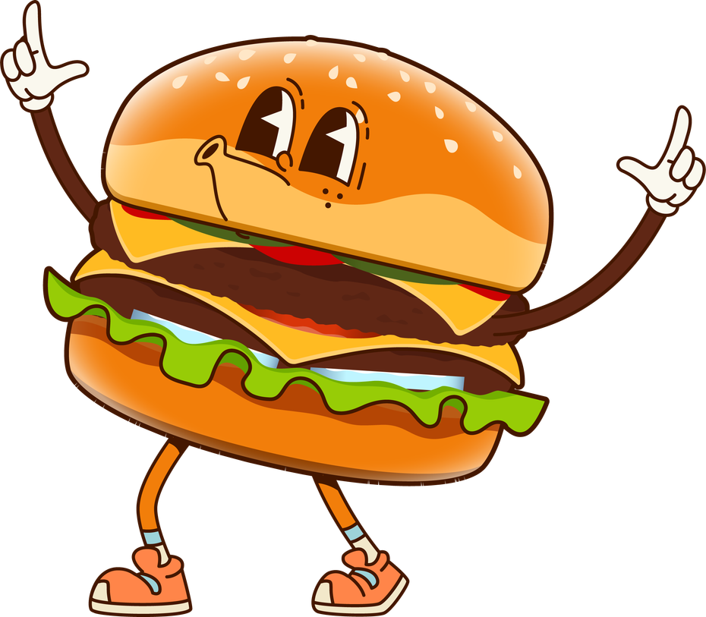

MON | TUE | WED | THU | FRI | SAT | SUN
 |  |  |  | 1 | 2
4 | 5 | 6 | 7 | 8 | 9 | 3
11 | 12 | 13 | 14 | 15 | 16 | 10
18 | 19 | 20 | 21 | 22 | 23 | 17
25 | 26 | 27 | 28 | 29 | 30 | 24
 |  |  |  |  |  | 31
05
NATIONAL MILITARY APPRECIATION MONTH
NATIONAL MOTHER GOOSE DAY
ASH- NO 4K, K-12 EARKY RELEASE
WDP- 4K-4TH, NO SCHOOL
MONTHLY CALENDAR
NATIONAL TEACHER APPRECIATION DAY
MR. EVAN SHARES HIS TRAIN’S
NATIONAL TRAIN DAY
NATIONAL TEACHER APPRECIATION WEEK
NATIONAL APPLE PIE DAY
ASH- NO 4K, K-12 EARKY RELEASE
MOTHERS DAY
NATIONAL PIZZA PARTY DAY
NATIONAL DEVILS FOOD CAKE DAY
PAJAMA DAY
MAY 2026
NATIONAL GRAPE DAY
NATIONAL HAMBURGER DAY

