Slide 1


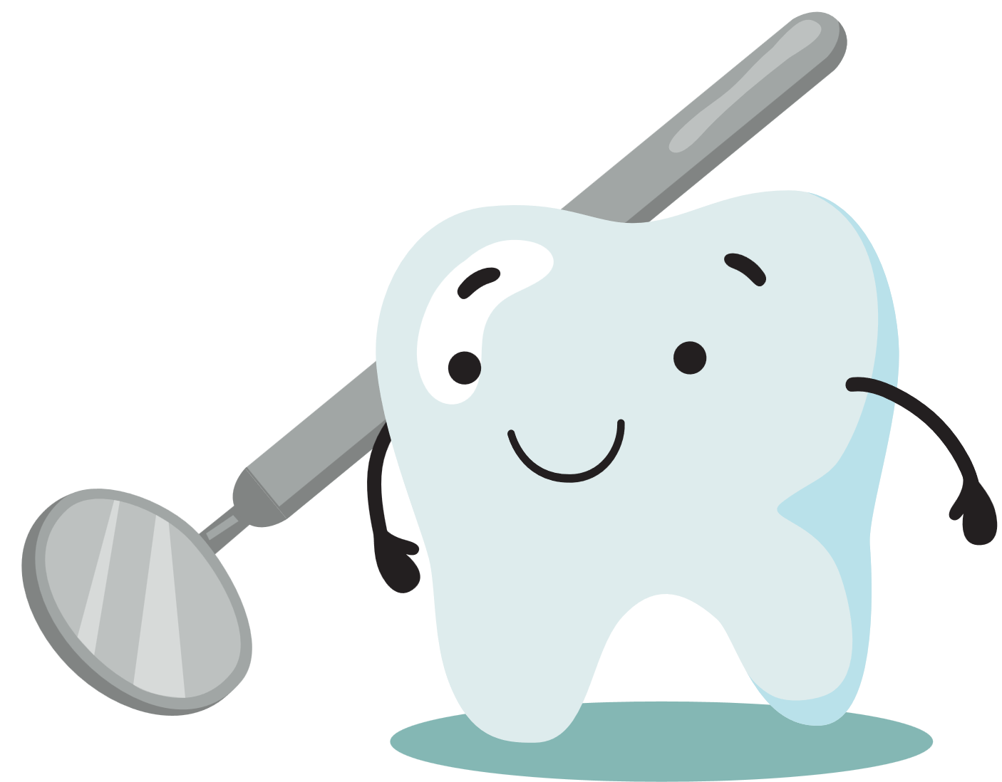

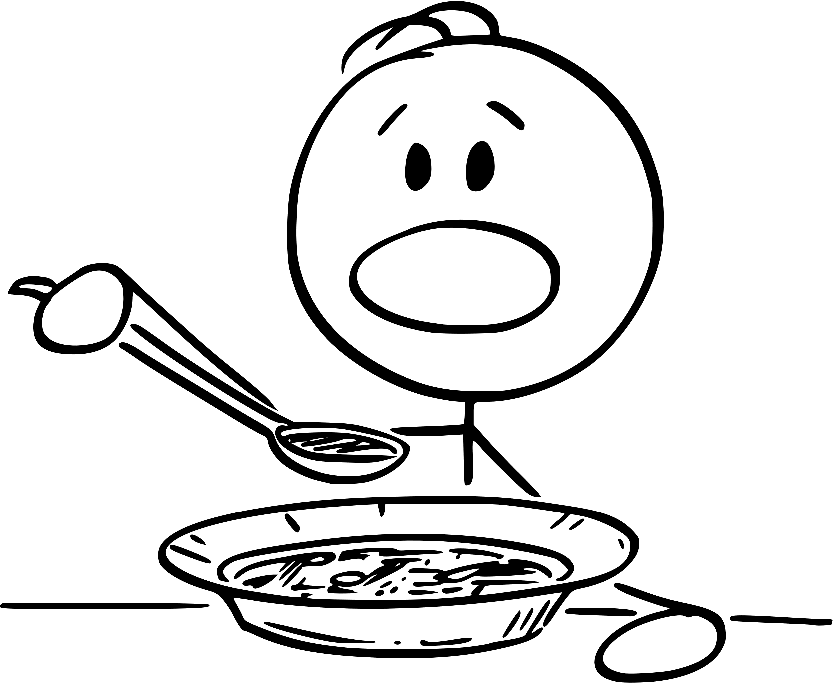
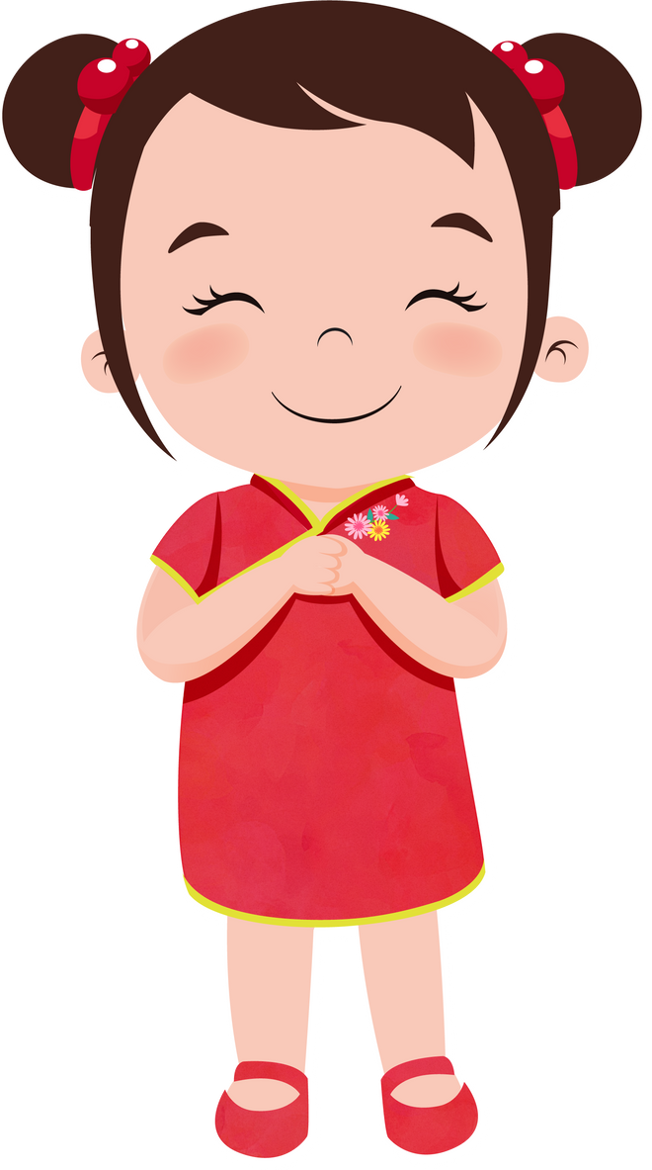
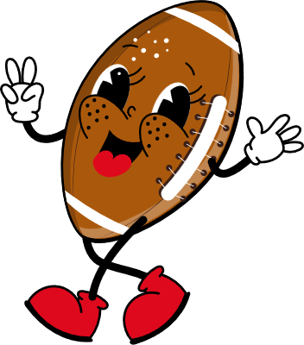

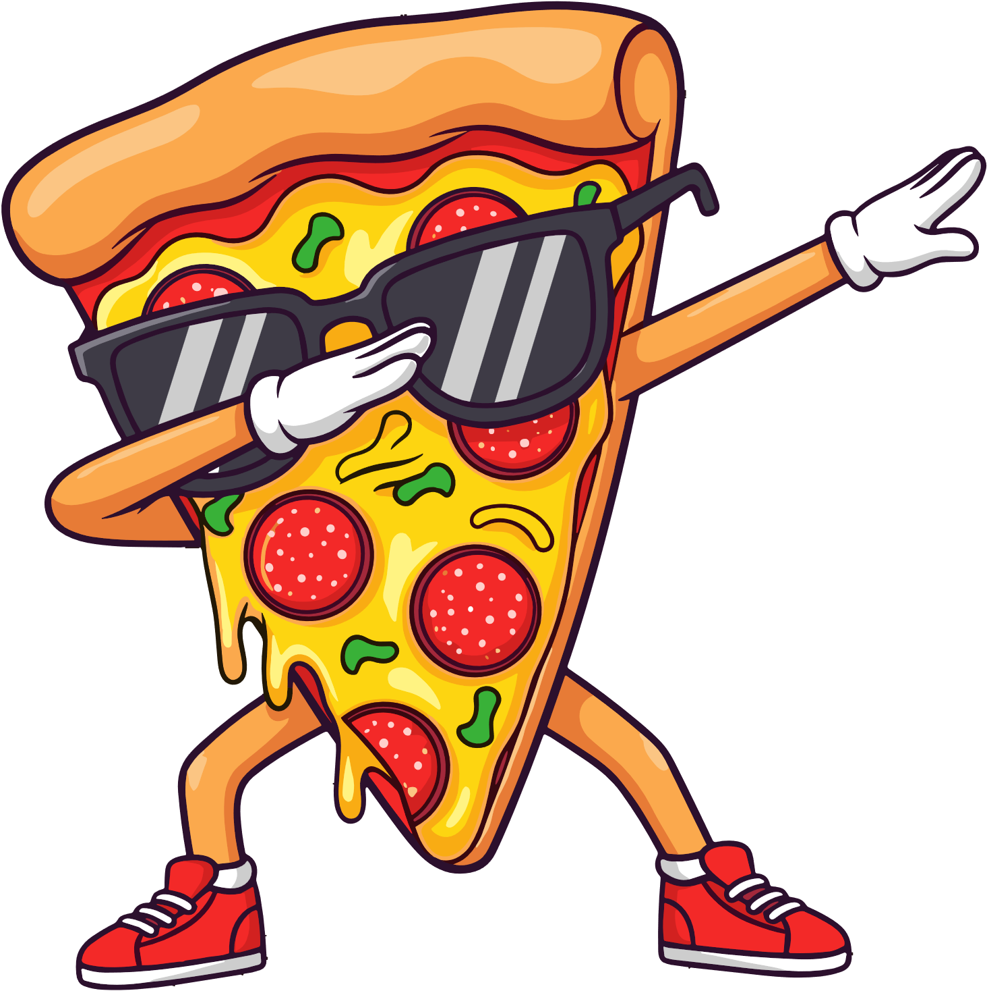






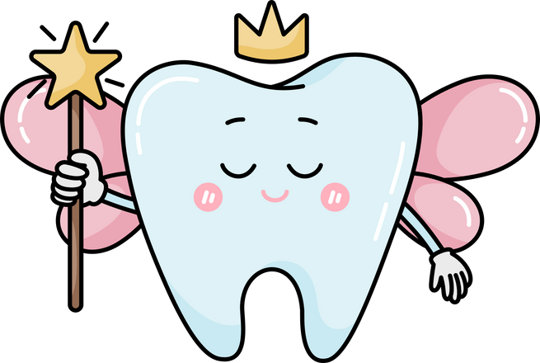



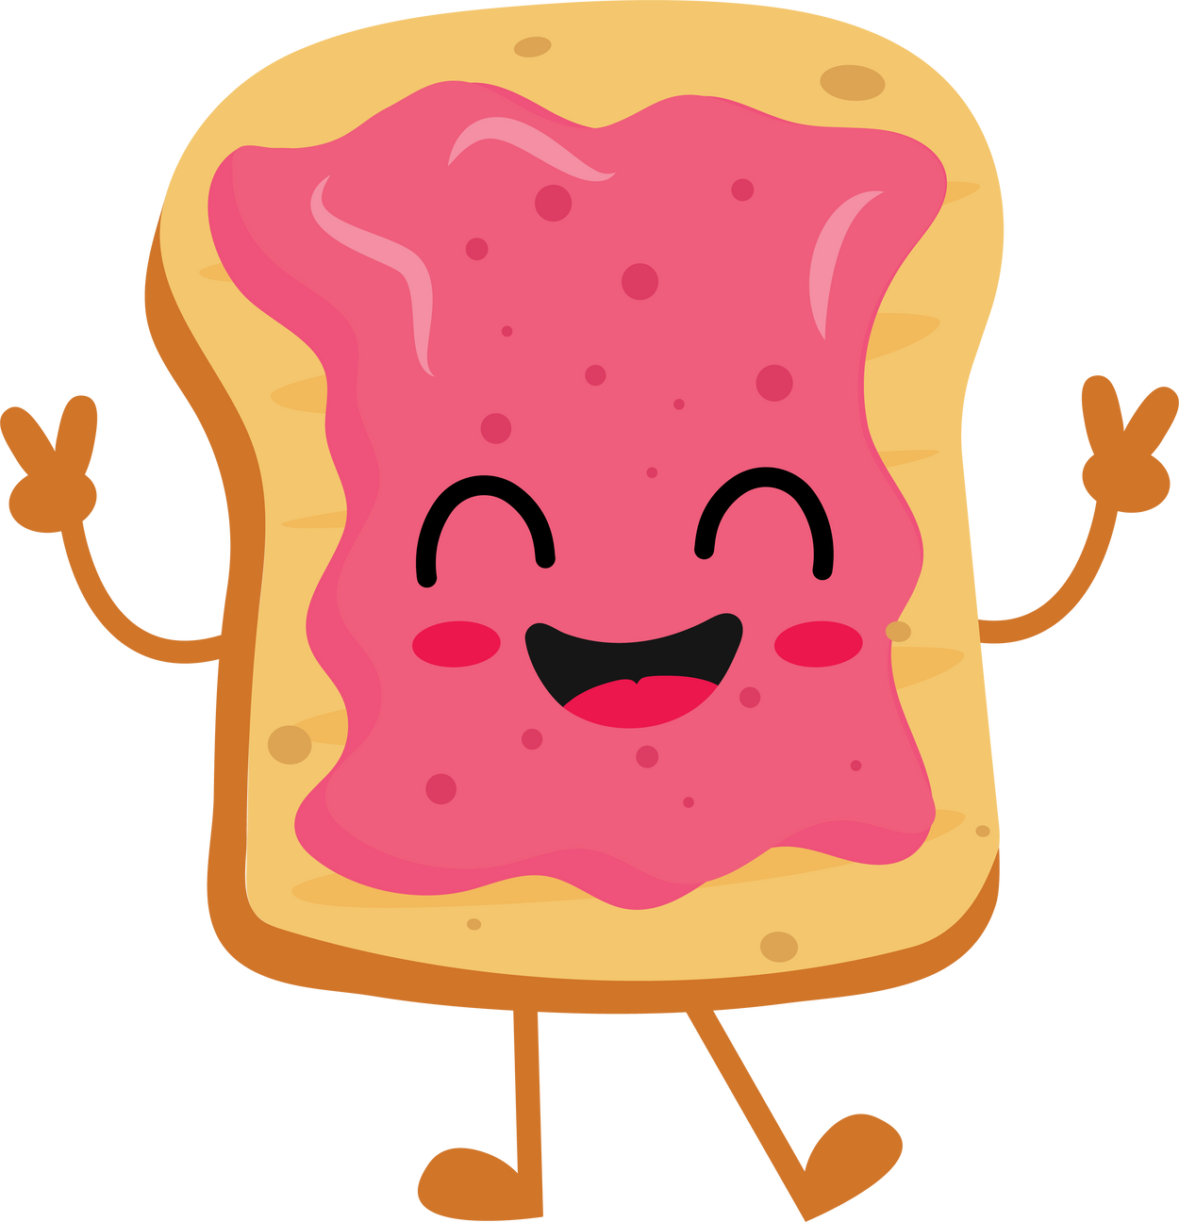

February
02
2026
Monday
Tuesday
Wednesday
Thursday
Friday
Saturday
Sunday
1
Children’s Dental Health Awareness Month
2
3
4
5
6
7
8
National Homemade Soup Day
Superbowl Sunday
Groundhogs Day
National Wear Red Day
9
10
11
12
13
14
15
National Pizza Day
National Flannel Day
National Cheddar Day
Valentines Day
16
17
18
19
20
21
22
Pajama Day
Fat Tuesday
ASH: ½ Day No4K
WDP/ ASH No School
23
24
25
26
27
28
National Pink Shirt Day
National Toast Day
National Tooth Fairy Day

